Slide 1

RabbitMQ
Problems and solutions to improve performance by RabbitMQ
Best practices
Author: Tai.Vo

Slide 2
Agenda
Overview RabbitMQ
Solutions to improve performance by RabbitMQ
Best practices

Slide 3
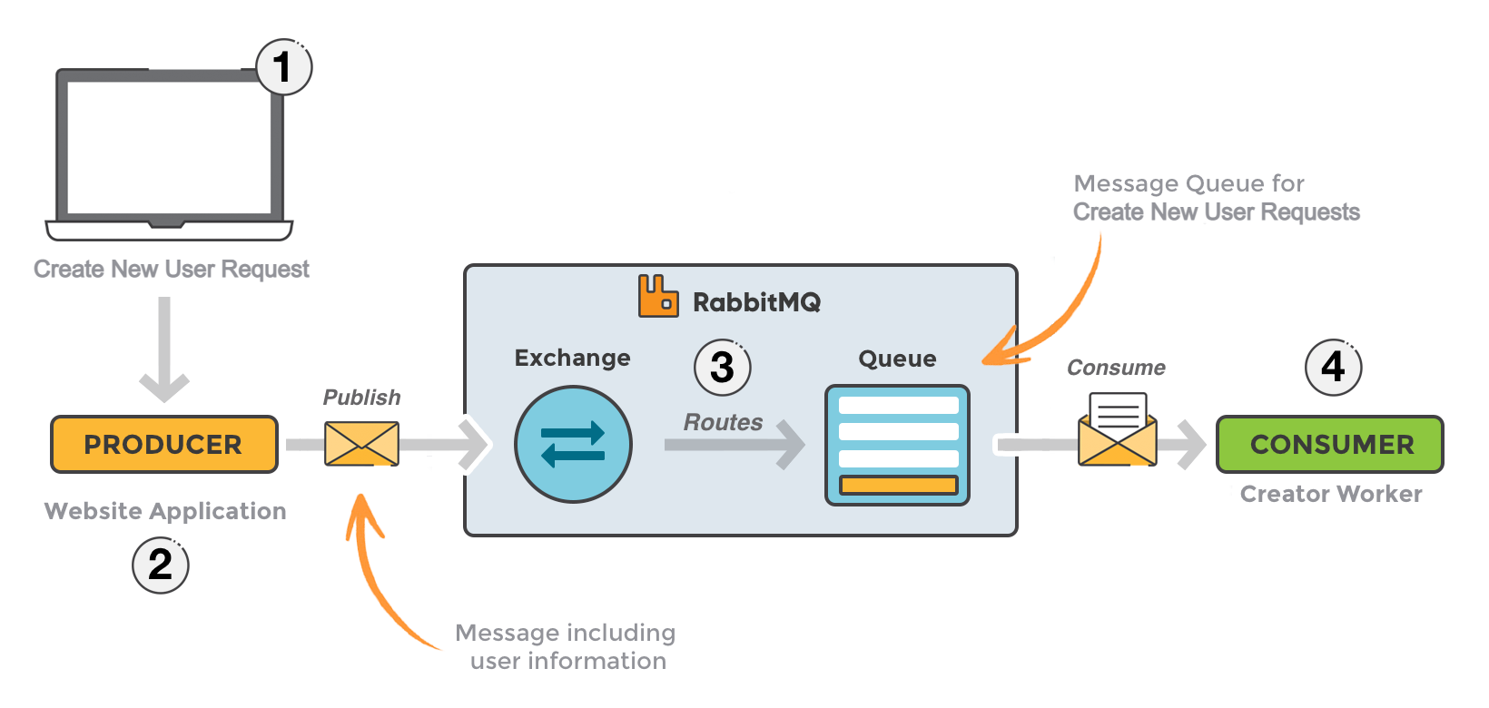
Overview - Big Picture

Slide 4
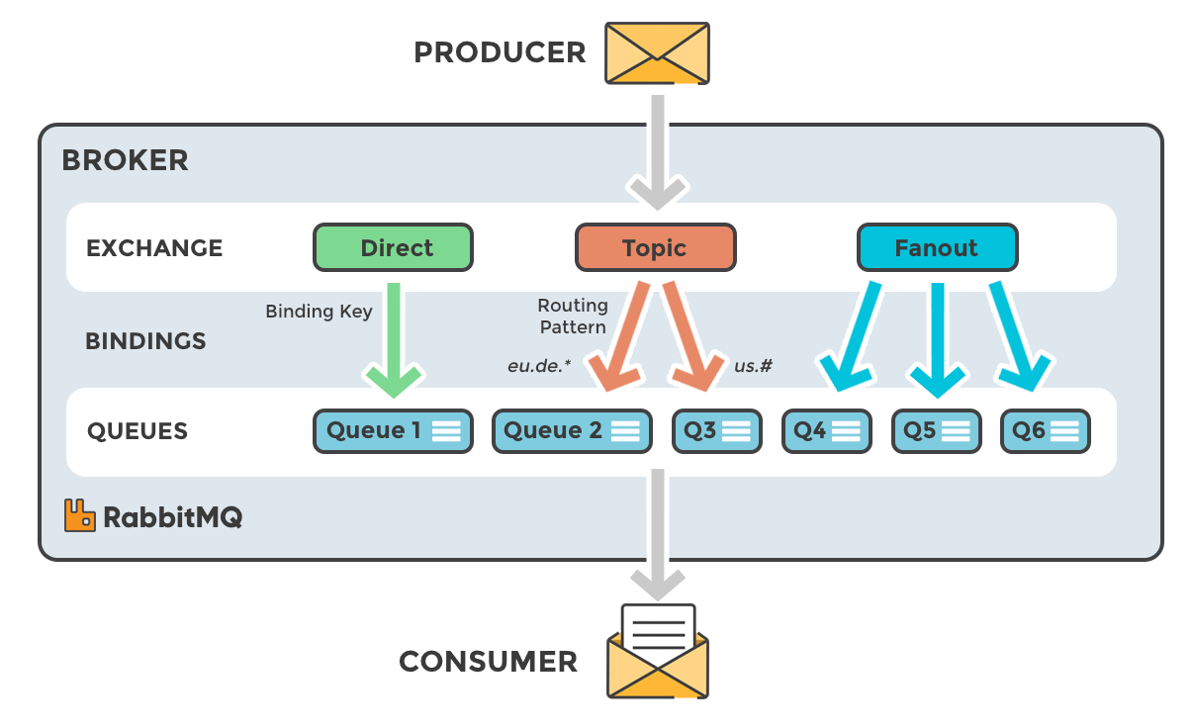
Overview - Type Of Exchanges

Slide 5
Overview - Type Of Exchanges
Direct: The message is routed to the queues whose binding key exactly matches the routing key of the message. For example, if the queue is bound to the exchange with the binding key userprocess, a message published to the exchange with a routing key userprocess is routed to that queue.
Fanout: A fanout exchange routes messages to all of the queues bound to it.
Topic: The topic exchange does a wildcard match between the routing key and the routing pattern specified in the binding.
Headers: Headers exchanges use the message header attributes for routing.

Slide 6
Overview - Concepts
Producer: Application that sends the messages.
Consumer: Application that receives the messages.
Queue: Buffer that stores messages.
Message: Information that is sent from the producer to a consumer through RabbitMQ.
Connection: A TCP connection between your application and the RabbitMQ broker.
Channel: A virtual connection inside a connection. When publishing or consuming messages from a queue - it's all done over a channel.

Slide 7
Overview - Concepts
Exchange: Receives messages from producers and pushes them to queues depending on rules defined by the exchange type. To receive messages, a queue needs to be bound to at least one exchange.
Binding: A binding is a link between a queue and an exchange.
Routing key: A key that the exchange looks at to decide how to route the message to queues. Think of the routing key like an address for the message.
AMQP: Advanced Message Queuing Protocol is the protocol used by RabbitMQ for messaging.

Slide 8
Overview - Concepts
Users: It is possible to connect to RabbitMQ with a given username and password. Every user can be assigned permissions such as rights to read, write and configure privileges within the instance. Users can also be assigned permissions for specific virtual hosts.
Vhost, virtual host: Provides a way to segregate applications using the same RabbitMQ instance. Different users can have different permissions to different vhost and queues and exchanges can be created, so they only exist in one vhost.
Cluster: A cluster consists of a set of connected computers that work together. If the RabbitMQ instance consisting of more than one node - it is called a RabbitMQ cluster. A cluster is a group of nodes i.e., a group of computers.
Node: A node is a single computer the RabbitMQ cluster.

Slide 9
Solutions
Use the specific exchange for the specific purpose
Setup Dead Letter exchange and TTL to scale down the queue
Use lazy queues
Custom ack for timeout response
Set auto ack for consumers and prefetch for queue

Slide 10
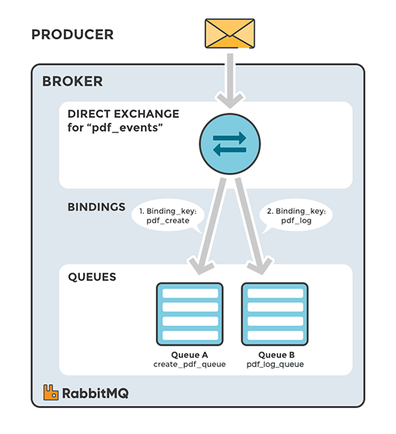
Solutions - Direct Exchange
The direct exchange type is useful to distinguish messages published to the same exchange using a simple string identifier.

Slide 11
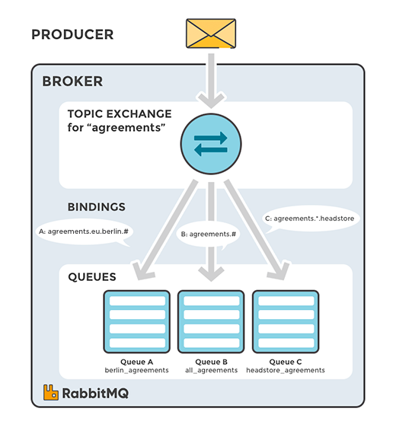
Solutions - Topic Exchange
The Topic exchange type is useful for directing messages based on multiple categories.

Slide 12
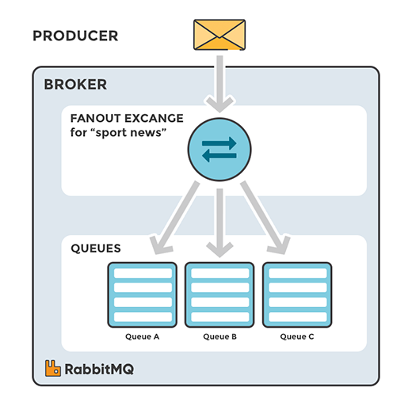
Solutions - Fanout Exchange
Fanout exchanges can be useful when the same message needs to be sent to one or more queues with consumers who may process the same message in different ways.

Slide 13
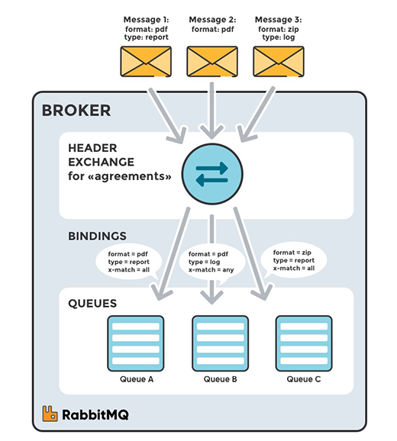
Solutions - Headers Exchange
Headers exchanges are very similar to topic exchanges, but route messages based on header values instead of routing keys. A message matches if the value of the header equals the value specified upon binding

Slide 14
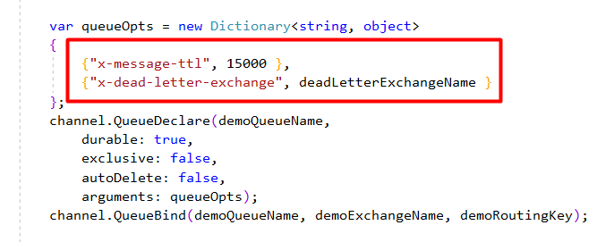
Solutions - Dead Letter Exchange and TTL
Short TTL to scale down the number of messages in the queue
Dead Letter Exchange used to handle long response messages

Slide 15
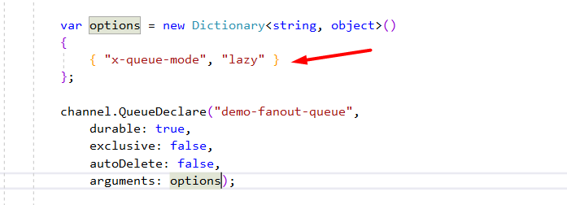
Solutions - Lazy Queues
Queues that move their contents to disk as early as practically possible, and only load them in RAM when requested by consumers.

Slide 16
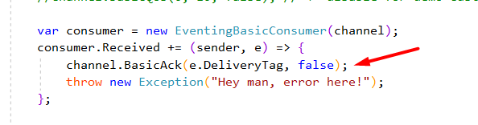
Solutions - Custom Ack
Use custom ack for long response tasks to move forward to the next messages

Slide 17
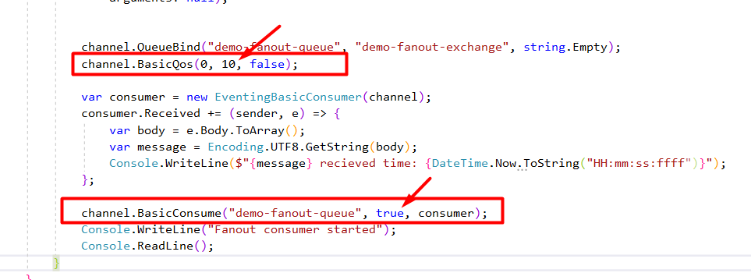
Solutions - Auto Ack and Prefetch Count
Set Prefetch Count value to limit the number of messages received at the same time.
Set Auto Ack is true to prevent mistakes and save the waiting time.

Slide 18
Best practices
Don’t open and close connections or channels repeatedly
Don’t use too many connections or channels.
Don’t share channels between threads.
Don't have queues that are too large or too long.
Don't use old RabbitMQ/Erlang versions or RabbitMQ clients/libraries.
Don't have an unlimited prefetch value.
Don't ignore lazy queues.
Limit queue size with TTL or max-length, if possible.

Slide 19
Best practices
Use multiple queues and consumers.
Persistent messages and durable queues for a message to survive a server restart.
Split your queues over different cores (RabbitMQ sharding plugin).
Consume (push), don’t poll (pull) for messages (BasicGet vs BasicConsume).

Slide 20
RabbitMQ
Q & A

Slide 21
RabbitMQ
THANK YOU!!!

